Slide 1
PROVA
Proof Over Promises
A social accountability platform that makes goals visible — and follow-through inevitable.

Slide 2
“
Everyone sets goals. Almost no one follows through.
PROVA is built on one idea: proof over promises.

Slide 3
THE PROBLEM
Goals fail by design.
92%
The tools we use to pursue goals were never built to keep us accountable.

Slide 4
THE PROBLEM
92% of people never reach their goals
HABIT TRACKERS
SOCIAL MEDIA
Private and silent — easy to ignore when nobody's watching.
Performative, not accountability-driven. Highlight reels, not real progress.
No product makes accountability both social and supportive — until now.

Slide 5
OUR SOLUTION
If people are watching, you show up.
PROVA turns accountability into a social, low-pressure experience.

Slide 6
HOW PROVA WORKS
Set goals. Post proof. Stay consistent.
1
2
3
Share your goal
Post proof
Build consistency
Add accountability partners — friends or community.
Photo, video, or text — real evidence of real progress.
Encouragement, reactions, and gentle accountability — not pressure.

Slide 7
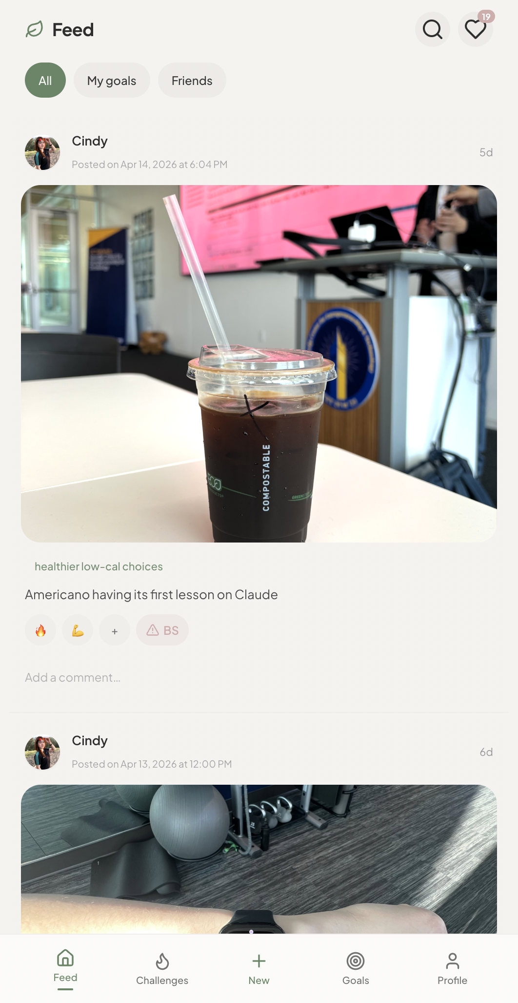
THE PRODUCT
A social feed built around accountability.
Goal creation + accountability partner invites
Proof posts — photo, video, or text updates
Social feed of progress from your circle
Reactions, encouragement, and gentle nudges
Accountability visibility — who saw your update

Slide 8
WHY NOW
The moment has arrived.
• Social sharing is normalized — accountability is the missing layer
• Social apps moving toward smaller, more intentional communities
• Rise of 'soft productivity' and wellness culture among Gen Z
• AI makes building easy — execution and behavior change matter more
• Burnout from performative platforms is accelerating
• Users want supportive spaces, not highlight reels
PROVA sits at the intersection of social media, productivity, and habit tracking — a category that doesn't yet exist.

Slide 9
MARKET OPPORTUNITY
A $40B+ market, underserved.
TAM
SAM
SOM
$40B+
[SAM]
[SOM]
Global self-improvement market
Habit tracking & productivity apps
Gen Z + young professionals, wellness focus
Even capturing a small percentage of an active, paying user base translates to a significant revenue opportunity.

Slide 10
BUSINESS MODEL
Engagement first, revenue second.
PRIMARY — B2B PARTNERSHIPS
FUTURE — CONSUMER
• Brands create accountability challenges on PROVA
• Freemium: Free basic → $2.99/mo unlimited goals + analytics
• Users join, post proof, earn rewards
• Group accountability plans — paid challenges ($5–10)
• Brands pay for engagement, exposure, and motivated users
• Creator-led groups with revenue share
• Example: fitness brands, athleisure, wellness companies
"Optimizing for engagement first — revenue follows community."

Slide 11
TRACTION
Early signals, real momentum.
[X]
[X]%
[X]%
Early users signed up
Created at least one goal
Engaged with accountability features
"Several users expressed strong interest in paying for premium tools. A majority engaged with social accountability features — the core mechanic — on day one."

Slide 12
COMPETITIVE LANDSCAPE
We sit at the intersection no one owns.
Social
Accountability
Supportive
✓ PROVA
✓
✓
✓
Habitica / Streaks
✗
✓
✗
Instagram / TikTok
✓
✗
✗
Strava / Fitness apps
✓
✗
✗

Slide 13
“
PROVA makes accountability feel supportive, not stressful.
A support system, not pressure. A community, not a tool. A place for consistent growth — together.

Slide 14
THE TEAM
Built by people who live the problem.
●
[Founder Name]
●
[Team Member]
[Role]
[Role]
[Background / expertise]
[Background / expertise]
Early users are actively shaping the product — community-driven development from day one.

Slide 15
FUNDING ASK
Seed the proof of concept.
$5K–$10K
To enhance development, accelerate user testing, and validate our core accountability mechanics with real users at scale.
Milestone 1
Milestone 2
Milestone 3
Scale to 1,000 users. Prove engagement with accountability features.
Launch first B2B brand challenge. Validate the partnership model.
Demonstrate product-market fit and position for next funding round.

Slide 16
PROVA
In a world full of intentions, PROVA makes action visible.
Thank you. We’d love to answer your questions.

